Slide 1

Virtual Paathshala
Conceptualized by :-
Rati Bhutkar
Niketa Mhatre
Neha Dubey
Priyasha Anuradha
Sushravya Poojary
Mentor – Ajay Viradiya

Slide 2
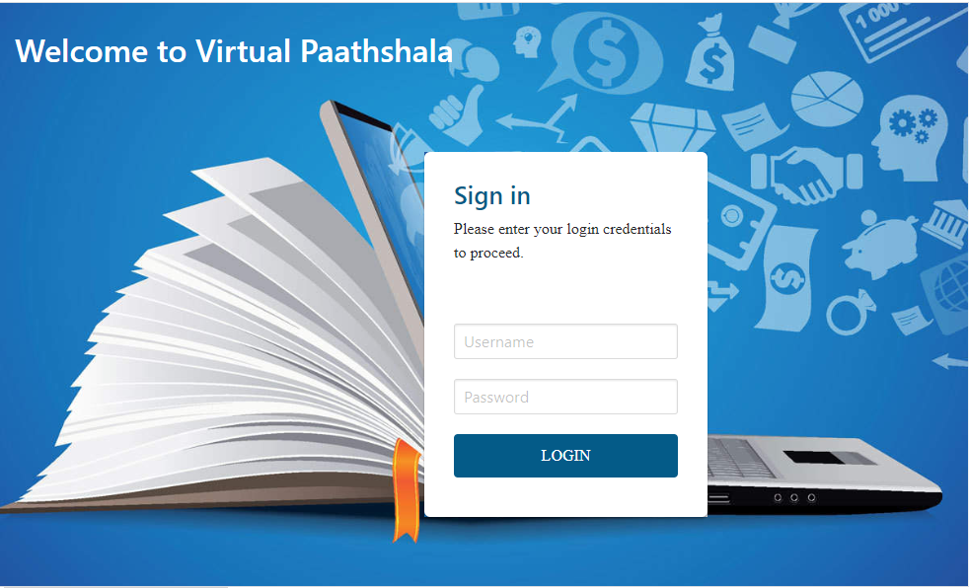
Login Page
By entering a unique Username and Password, one can login to the Virtual Paathshala.

Slide 3
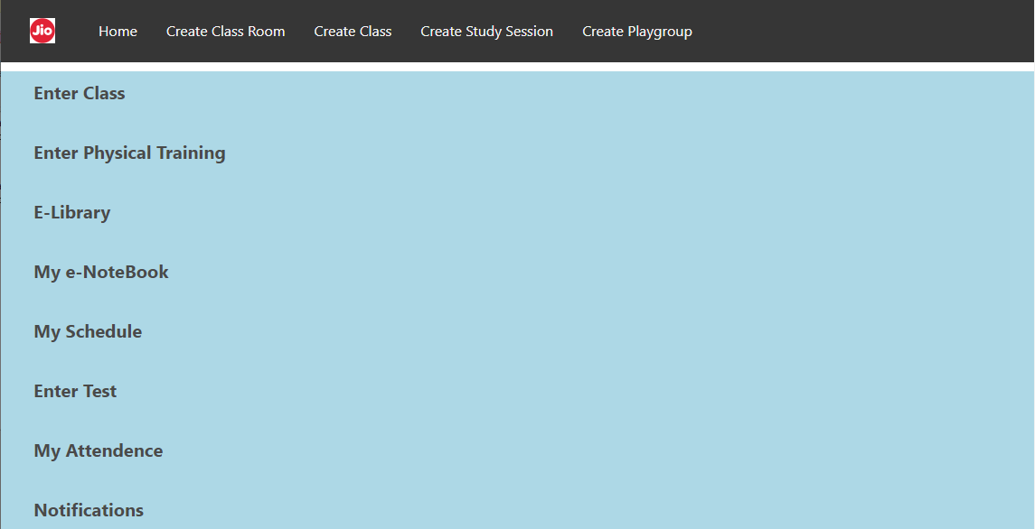
Home Page
A Virtual Paathshala user’s age can range from 5 to 60 & above. Considering this fact, the Home page is kept simple and user friendly.

Slide 4
Salient Features
Apart from the features seen on already available applications, we have introduced some unique ones,
2- way Communication → With eNote Sharing feature , visibility of student’s Notebook to teacher along-with private chat during an on-going session is possible
Scan Me → This feature will help identify restless kids by giving a prompt to not just the teacher but the student too. We believe, prompting a kid every time he/she gets out of frame will discourage him/her from fidgeting too much.
Controlled Chat → Chatting restriction rights are with the organizer of the class in order to provide a controlled environment & avoid inappropriate chats between students.
Test from Home → By involving AI, a camera can scan the examinee and his environment, detect suspicious activity and report the same. There will be no need of anyone to supervise the examinees. Moving forward, TFH could be the new normal.
Encourage Physical activity → E.P.T. is basically gym/dance/yoga classes that can be conducted by trainers with a scanning mode, which will calculate energy levels and rank every participant, to motivate them to do better.
E-library -> Systematic repository of all classes which can be viewed later in case students miss any session due to frequent network fluctuation, illness etc. Additionally all e-textbooks & guides will be available here

Slide 5
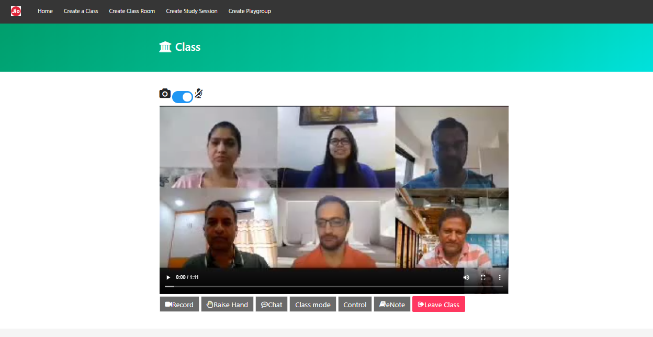
2- way Communication
A teacher can share screen and video to conduct a lecture, like any other application, but to encourage inputs from student end, we have introduced eNotebook sharing.
Also, if a student wants to privately discuss anything with the teacher, he/she can initiate a chat session with teacher only.

Slide 6
Scan Me
This feature is very effective and can be enabled to highlight if any student gets “out of frame”. Details of the same are provided in out Concept Paper. It requires coding at the backend and mapping with camera, which has been parked in our future scope. Please find the flow diagram, if “Scan Me” is enabled while creating a class,
Enter Class
No
Scan Me
Scan Body
Enter Class
Enter Class and Scan in background
Yes
No
Continue scanning in background
Send Alert “Out of Frame”
Out of Frame
Remove Alert when student adjusts himself

Slide 7
Controlled Chat
A teacher will be able to select what restriction he/she wants to apply on chatting, during an ongoing class.
Chat
Private Chat
Broadcast
Group Chat
Open a private chat with a student
Can be initiated by Teacher and Student
A Student cannot open a private chat with another student
2 way communication
Only a teacher can choose this option to broadcast a message to all participants
1 way communication
Only a teacher can initiate a group chat
All students will be part of this group chat
2 way communication

Slide 8
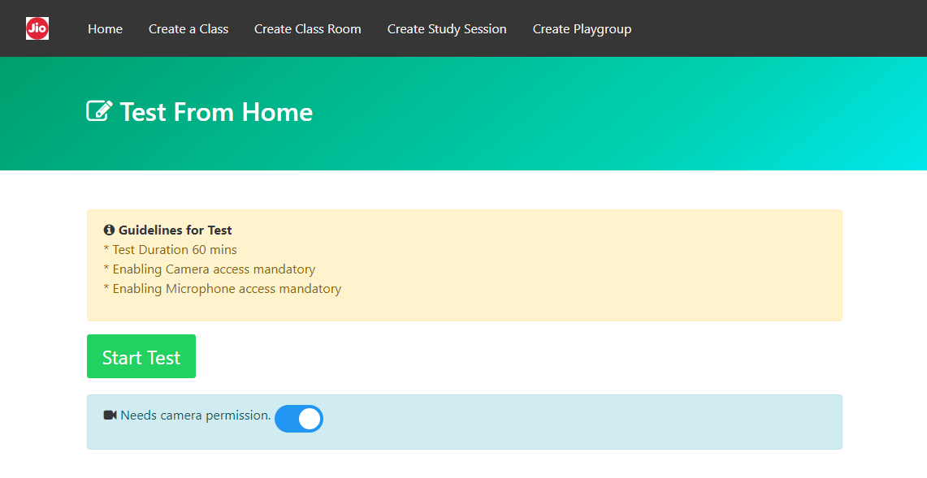
Test From Home

Slide 9
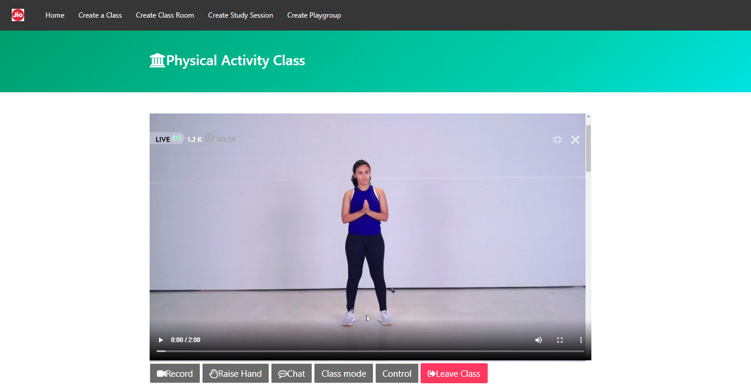
e-Physical Training
**The video used in the snapshot has been given for reference from a popular app, to show the Energy meter, Body scanning and Rank display.**
This is part of our future scope.

Slide 10
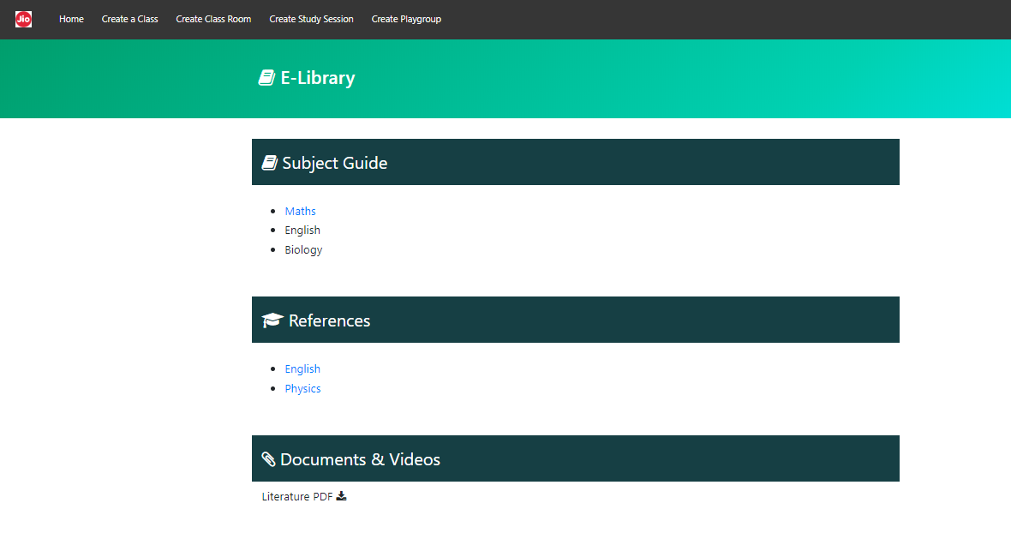
e-Library
Open access to textbooks, guides and reference material has been provided by default.
Access to class videos can be restricted.
Access rights can be decided by the school management.

Slide 11
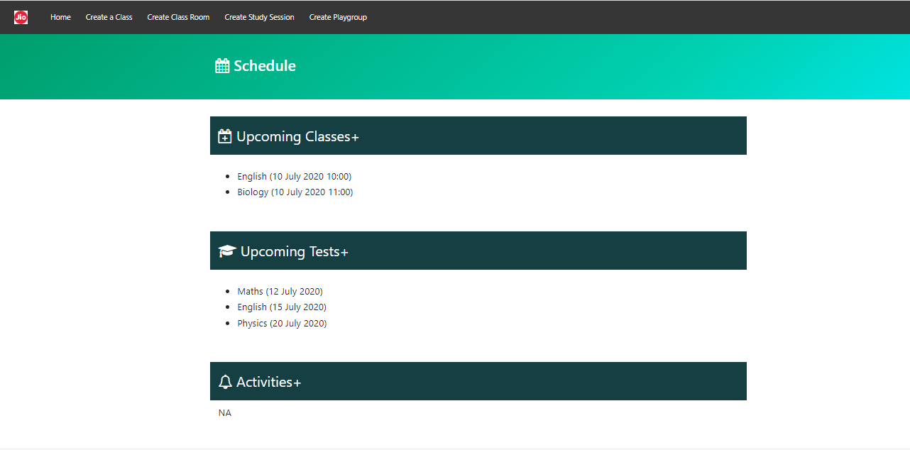
Schedule
Open access to Upcoming Classes, Upcoming Tests and Activities.

Slide 12
Conclusion
All the aspects and features of Virtual Paathshala have been designed after conducting a short survey.
Needs of teachers, students and parents have been focused on.
Implementing different technologies on one platform is our idea, that includes AI for Test from home, Image sensing for scanning and Interactive game sessions. Since advanced coding is required for these features we have kept it in our future scope. As of now we have created a web portal as a POC without API integration.
The level of virtualization of education and feature integration is high, and is not just useful for the current scenario. It can be the new normal in future.
We strive to work towards providing a rich platform that can be equivalent to an actual school. Everything virtually possible will be made available on our platform to ensure it is the best substitute to attending a school.
Hence our efforts will continue even after WiT Hackathon, until we our able to create a fully functional Virtual Paathshala web portal.

Slide 13
Thank you

